Slide 1
SDH Web Solutions
Business Analysis
Project Manager:
Martha Jean Schindler
Staff:
Amanda Dobbins
Client:
John Holm

Slide 2
Table of Contents
Executive Summary
Extended Enterprise Diagram
Extended Enterprise Narrative
Overall Business Analysis
Overall Business Analysis Executive Summary
Overall Business Analysis Table
Overall Business Analysis Table Narrative
Overall Business Analysis WCA Diagram
Overall Business Analysis WCA Narrative
Overall Business Analysis VC Diagram
Overall Business Analysis VC Narrative
Sell
Sell Table
Sell Table Narrative
Sell WCA Diagram
Sell WCA Narrative
Sell VC Diagram
Sell VC Narrative
Sell Work Steps
Contract for Services
Confidentiality Agreement
Research
Research Table
Research Table Narrative
Research WCA Diagram
Research WCA Narrative
Research VC Diagram
Research VC Narrative
Research Work Steps
Website Templates
Client Validation and Verification Agreement: Research
Deadline for Submission Agreement
Contract Detailing Goals and Specifications

Slide 3
Completed Client Questionnaire
Produce
Produce Table
Produce Table Narrative
Produce WCA Diagram
Produce WCA Narrative
Produce VC Diagram
Produce VC Narrative
Produce Work Steps
Link Example Page
Client Validation and Verification Agreement: Produce
Publishing the Website
Deliver
Deliver Table
Deliver Table Narrative
Deliver WCA Diagram
Deliver WCA Narrative
Deliver VC Diagram
Deliver VC Narrative
Deliver Work Steps
Completion of Project Agreement
Final Website Homepage
Final Website Personal Page
Final Website Personal PageLink
Final Website Photo Gallery Page
Final Website My Resume Page
Final Website Resume Link
Service
Service WCA Diagram
Service WCA Narrative
Service VC Diagram
Service VC Narrative
Service Table
Service Table Narrative
Service Work Steps
Extended Service Contract
Respository

Slide 4
EXTENDED ENTERPRISE
SDH Web Solutions

Slide 5
Extended Enterprise for SDH Web Solutions
Value Chain for Company ( Rep. Martha Jean Schindler)
Sell
Research
Produce
Deliver
Service
Value Chain for Client (John Holm)
Research
Sell
Produce
Deliver
Service
Value Chain for Customer (Website Visitors)
Research
Sell
Produce
Deliver
Service

Slide 6
Extended Enterprise for SDH Web Solutions
Narrative
Value Chain for Company: SDH Web Solutions will Deliver the requested product, the website, to the client, John Holm, through the work of company representative Martha Jean Schindler.
Value Chain for Client: After SDH Web Solutions representative Martha Jean Schindler delivers the website, Mr. Holm can Sell the website to his website visitors by convincing them to visit his site.
Value Chain for Customer: After Mr. Holm sells his website to potential visitors, the website visitors can use the information on the site to Research Mr. Holm’s scholarship potential.

Slide 7
OVERALL BUSINESS ANALYSIS
SDH Web Solutions

Slide 8
Overall Business Analysis
Executive Summary
I strongly recommend that John Holm enlist the services of SDH Web Solutions Project Manager Martha Jean Schindler (myself) to manage a project resulting in the creation of his personal website. SDH Web Solutions aims to provide a high level of service and quality in our business practices, and to provide a valuable product for our clients by employing knowledgeable representatives who are provided with a complete and practical methodology. By performing according to these company goals, I will offer Mr. Holm superior services and a superior product.
I will provide Mr. Holm with a customized website and maintenance of the site as requested. By acting with professionalism and providing a high quality product, I will build a solid relationship with Mr. Holm. This will improve SDH Web Solutions’ business image in his mind and the minds of other potential clients, leading to increased business. We will maintain a healthy business relationship with Mr. Holm while expanding into business relationships with other clients.
By creating Work Centered Analyses and corresponding Value Chains for Mr. Holm’s project, I determine that the steps in the project are to sell our services to Mr. Holm, research his individual needs, produce the website, deliver the website to him, and provide service updates as requested.

Slide 9
Overall Business Analysis
Table
OVERALL TABLE GOES HERE]

Slide 10
Overall Business Analysis
Table Narrative
Goal: We aim to provide a high level of service and quality in my business practices, and to provide a valuable product for John Holm by being a knowledgeable representative and following SDH Web Solutions’ complete and practical methodology.
Product: John Holm’s website
Value: By acting with professionalism and providing a high quality product,we will build a solid relationship with Mr. Holm. This will improve our business image in his mind and in the minds of other potential clients, leading to increased business.
Customer: John Holm
Tasks
    Sell: Using the SDH Web Solutions Handbook, sell to John Holm the benefits of a website produced by myself and SDH Web Solutions, and secure a contract for services.
        Result: Sales contract.
    Research: Research the Mr. Holm’s needs according to instructions in the SDH Web Solutions Handbook.
        Result: Mr. Holm’s specifications.
    Produce:. Produce a website for Mr. Holm based on specifications established in the Research Phase and SDH Web Solutions Handbook.
        Result: Prototype for Mr. Holm’s website.
    Deliver: Deliver Mr. Holm’s website by publishing it according to the SDH Web Solutions Handbook.
        Result: Published website.
    Service: Provide Service to Mr. Holm by securing Extended Service Agreement and answering his questions as required.
        Result: Signed Extended Service Contract and solutions as requested.
Role of Data: We will be provided SDH Web Solutions templates and guidelines to ensure quality of project management and the resulting product. Information provided by Mr. Holm will be used to customize the product and services according to his needs.
Role of People: We oversee decisions made regarding Mr. Holm and his site. Amanda Dobbins completes administrative work. Mr. Holm will be provided with our services.
Role of Technology: Computers, the internet, Microsoft Office, and email will be used for production of the website and communication among vested parties. Microsoft FrontPage and the web space will be used to produce and publish the site.

Slide 11
Overall Business Analysis
WCA
Data
SDH Web Solutions templates, guidelines
Information provided by John Holm
Participants
Martha Jean Schindler
Amanda Dobbins
John Holm
Technology
Computer
Internet
Microsoft Office
Email
Microsoft FrontPage
Web Space to Publish
Work Practices
Using SDH Web Solutions Handbook, Sell to Mr. Holm benefits of website produced by SDH Web Solutions; secure contract for services
Research Mr. Holm’s needs by following SDH Web Solutions Handbook
Produce website for Mr. Holm based on specifications established in Research Phase and SDH Web Solutions Handbook
Deliver Mr Holm’s website by publishing it according to SDH Web Solutions Handbook
Provide Service to Mr. Holm by securing Extended Service Agreement and answering his questions as required
Goal
We aim to provide a high level of service and quality in my business practices, and to provide a valuable product for Mr. Holm by being a knowledgeable representative and using SDH Web Solutions’ complete and practical methodology.
Product
John Holm’s website
Value
By acting with professionalism and providing a high quality product, we will build a solid relationship with John Holm. This will improve our business image in his mind and the minds of other potential clients, leading to increased business.
Customer
John Holm

Slide 12
Overall Business Analysis
WCA Narrative
Goal: We aim to provide a high level of service and quality in my business practices, and to provide a valuable product for Mr. Holm by being a knowledgeable representative and using SDH Web Solutions’ complete and practical methodology.
Product: John Holm’s website
Value: By acting with professionalism and providing a high quality product, we will build a solid relationship with John Holm. This will improve our business image in his mind and the minds of other potential clients, leading to increased business.
Customer: John Holm
Work Practices
    Sell: Using the SDH Web Solutions Handbook, Sell to Mr. Holm the benefits of a website produced by SDH Web Solutions, and secure a contract for services.
    Research: Research the Mr. Holm’s needs according to instructions in the SDH Web Solutions Handbook.
    Produce:. Produce a website for Mr. Holm based on specifications established in the Research Phase and SDH Web Solutions Handbook.
    Deliver: Deliver the Mr. Holm’s website by publishing it according to the SDH Web Solutions Handbook.
    Service: Provide Service to the Mr. Holm by securing Extended Service Agreement and answering his questions as required.
Role of Data: We will be provided SDH Web Solutions templates and guidelines to ensure quality of project management and the resulting product. Information provided by Mr. Holm will be used to customize the product and services according to his needs.
Role of People: We oversee decisions made regarding John Holm and his site. Amanda Dobbins completes administrative work. Mr. Holm will be provided with our services.
Role of Technology: Computers, the internet, Microsoft Office, and email will be used for production of the website and communication among vested parties. Microsoft FrontPage and the web space will be used to produce and publish the site.

Slide 13
Overall Business Analysis
VC
Using SDH Web Solutions Handbook, Sell to Mr. Holm the benefits of website produced by SDH Web Solutions; secure contract for services
Value
By acting with professionalism and providing a high quality product, We will build a solid relationship with John Holm. This will improve our business image in his mind and the minds of other potential clients, leading to increased business.
Sales Contract
Research Mr. Holm’s needs by following SDH Web Solutions Handbook
Mr. Holm’s Specifications
Produce website for Mr. Holm based on specifications established in Research Phase and SDH Web Solutions Handbook
Prototype for Mr. Holm’s Website
Deliver Mr. Holm’s website by publishing it according to SDH Web Solutions Handbook
Published Website
Product
A Website for Mr. Holm
Provide Service to Mr. Holm by securing Extended Service Agreement and answering his questions as required
Signed Extended Service Contract and Solutions as Requested

Slide 14
Overall Business Analysis
VC Narrative
Product: A website for Mr. Holm.
Value: By acting with professionalism and providing a high quality product, we will build a solid relationship with John Holm. This will improve our business image in his mind and the minds of other potential clients, leading to increased business.
Work Practices
    Sell: Using the SDH Web Solutions Handbook, sell to John Holm the benefits of a website produced by myself and SDH Web Solutions, and secure a contract for services.
        Result: Sales contract.
    Research: Research the Mr. Holm’s needs according to instructions in the SDH Web Solutions Handbook.
        Result: Mr. Holm’s specifications.
    Produce:. Produce a website for Mr. Holm based on specifications established in the Research Phase and SDH Web Solutions Handbook.
        Result: Prototype for Mr. Holm’s website.
    Deliver: Deliver Mr. Holm’s website by publishing it according to the SDH Web Solutions Handbook.
        Result: Published website.
    Service: Provide Service to Mr. Holm by securing Extended Service Agreement and answering his questions as required.
        Result: Signed Extended Service Contract and solutions as requested.

Slide 15
BUSINESS ANALYSIS: SELL
SDH Web Solutions

Slide 16
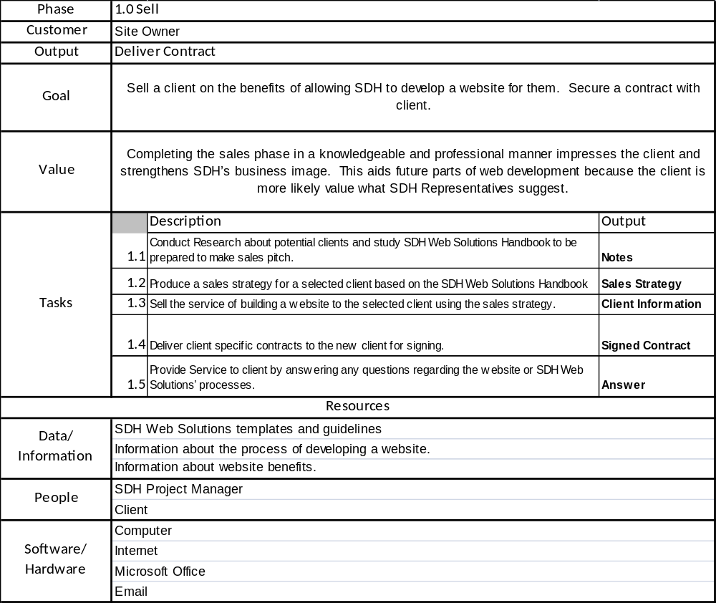
Business Analysis: Sell
Table

Slide 17
Business Analysis: Sell
Table Narrative
Goal: Complete a sale to John Holm by convincing him of the benefits SDH Web Solutions offers in personalized website development and secure a contract to provide a website.
Product: Signed Contract to develop Website.
Value: Completing the sales phase in a knowledgeable and professional manner favorably impresses Mr. Holm and strengthens SDH’s business image. This will facilitate future phases of the web development because he will be more likely to respect and value what I and other SDH Representatives suggest or do.
Customer: John Holm
Tasks
    Research: Conduct Research about John Holm’s relevant needs and study the SDH Web Solutions Handbook in preparation of the sale.
        Result: Notes.
    Produce: Produce a sales strategy for Mr. Holm based on the SDH Web Solutions Handbook.
        Result: Sales Strategy.
    Sell: Sell service of building website to Mr. Holm using sales strategy.
        Result: Client Information.
    Deliver: Deliver client specific contracts to Mr. Holm for signing.
        Result: Signed Contracts.
    Service: Provide Service to Mr. Holm by answering any questions regarding the website or SDH Web Solutions’ processes.
        Results: Answers to Mr. Holm’s questions.
Role of Data/Information: SDH Web Solutions templates and guidelines will be provided to myself and all employees to ensure quality of project management and the resulting product. Information about the website development process will be used to explain possible methods of customization and service to Mr. Holm. Information about the benefits of website will be used to further demonstrate reasons why he should use SDH Web Solutions.
Role of People: I will initiate and complete the sales process and Mr. Holm will purchase or decline our services.
Role of Software/Hardware: Computers, the internet, Microsoft Office, and email will be used for production of the website and communication among vested parties.

Slide 18
Business Analysis: Sell
WCA
Data
SDH Web Solutions templates
Information about website development process
Information about benefits of website
Participants
Martha Jean Schindler
Mr. Holm
Technology
Computer
Internet
Microsoft Office
Email
Work Practices
Conduct Research about Mr. Holm and study SDH Web Solutions Handbook in preparation of sale
Produce sales strategy for Mr. Holm based on SDH Web Solutions Handbook
Sell service of building website to Mr. Holm using sales strategy
Deliver client specific contracts to new Mr. Holm for signing
Provide Service to Mr. Holm by answering any questions regarding website or SDH Web Solutions’ processes
Goal
Complete a sale to Mr. Holm by convincing him or her of the benefits SDH Web Solutions offers in personalized website development and secure a contract to provide a website.
Product
Signed Contract to develop Website
Value
Completing the sales phase in a knowledgeable and professional manner favorably impresses Mr. Holm and strengthens SDH’s business image. This will facilitate future phases of the web development because Mr. Holm will be more likely to respect and value what the SDH Representatives suggest or do.
Customer
Mr. Holm

Slide 19
Business Analysis: Sell
WCA Narrative
Goal: Complete a sale to Mr. Holm by convincing him of the benefits SDH Web Solutions offers in personalized website development and secure a contract to provide a website.
Product: Signed Contract to develop Website.
Value: Completing the sales phase in a knowledgeable and professional manner favorably impresses Mr. Holm and strengthens SDH’s business image. This will facilitate future phases of the web development because Mr. Holm will be more likely to respect and value what the SDH Representatives suggest or do.
Customer: Mr. Holm
Work Practices
    Research: Conduct Research about Mr. Holm and study the SDH Web Solutions Handbook in preparation of the sales.
    Produce: Produce a sales strategy for Mr. Holm based on the SDH Web Solutions Handbook.
    Sell: Sell service of building website to Mr. Holm using sales strategy.
    Deliver: Deliver client specific contracts to Mr. Holm for signing.
    Service: Provide Service to Mr. Holm by answering any questions regarding the website or SDH Web Solutions’ processes.
Role of Data: SDH Web Solutions templates and guidelines will be provided to all employees to ensure quality of project management and the resulting product. Information about the website development process will be used to explain possible methods of customization and service to Mr. Holm. Information about the benefits of website will be used to further demonstrate to Mr. Holm reasons why he or she should use SDH Web Solutions.
Role of People: Martha Jean Schindler will initiate and complete the sales process and Mr. Holm will purchase or decline our services.
Role of Technology: Computers, the internet, Microsoft Office, and email will be used for production of the website and communication among vested parties.

Slide 20

Business Analysis: Sell
VC
Value
Completing the sales phase in a knowledgeable and professional manner impresses Mr. Holm and strengthens SDH’s business image. This will aid future parts of the web development because Mr. Holm will be more likely to respect and value what the SDH Representatives suggest or do.
Notes
Produce sales strategy for Mr. Holm based on SDH Web Solutions Handbook
Sales Strategy
Sell service of building website to Mr. Holm using sales strategy
Client Information
Deliver client specific contracts to Mr. Holm for him to sign
Signed Contracts
Product
Signed Contract to develop website
Provide Service to Mr. Holm by answering any questions regarding website or SDH Web Solutions’ processes
Answer to Mr. Holm’s Questions

Slide 21
Business Analysis: Sell
VC Narrative
Product: Signed Contract to Develop Website
Value: Completing the sales phase in a knowledgeable and professional manner impresses Mr. Holm and strengthens SDH’s business image. This will aid future parts of the web development because Mr. Holm will be more likely to respect and value what the SDH Representatives suggest or do.
Work Practices
  Research: Conduct Research about potential clients and study the SDH Web Solutions Handbook in preparation of sales pitch.
    Result: Notes.
  Produce: Produce sales strategy for selected client based on SDH Web Solutions Handbook
    Result: Sales Strategy.
  Sell: Sell the service of website production to the selected client using the sales strategy.
    Result: Client Information.
  Deliver: Deliver client specific contracts to new Mr. Holm for him or her to sign.
    Result: Signed Contracts.
  Service: Provide Service to Mr. Holm by answering any questions regarding website or SDH Web Solutions’ processes.
    Result: Answer to client’s questions.

Slide 22
Business Analysis: Sell
Work Steps
Meet with potential client
Sell client on benefits
  Information available whenever potential visitors want to access it
  “Cutting Edge” method to present information will leave an impact on visitors
  Client can have information presented according to personalized specifications
  Answer any questions client may have
Provide detailed steps about the website creation process
  Inform client of all steps required to complete the Research, Develop, Deliver, and Service Phases
  Answer any questions client may have
Go over terms of contract with client
  Inform client of all elements of the contract.
    Prices
    Deadlines involved with completing website
    Client validation and verification forms
    Client Confidentiality
    Future Service Agreements
  Gather all required information to fill in contracts
Fill in contract templates with client and contract specific information
Have new client sign all relevant contracts for Sell Phase
  Contract for Services
  Confidentiality Agreement

Slide 23
SDH Web Solutions
2215 Paul W Bryant Dr
Tuscaloosa, AL 35401
(256) 683-4276
Contract for Services
______________________________, later referred to as the Client, has agreed to hire SDH Web Solutions to develop a website, later referred to as the Site. SDH Web Solutions will complete the Site by implementing specifications which be constructed from detailed research about the client’s goal gathered by SDH Representatives. The Site shall be fully operational by ____________.
The client agrees to pay SDH Web Solutions $__________ to build a website. The client may cancel this contract up to ____________ and will be held responsible for fifty percent of the original fee. Otherwise, this is a permanently binding agreement.
______________________________________ ___________________
Client Date
______________________________________ ___________________
SDH Project Manager Date

Slide 24
SDH Web Solutions
2215 Paul W Bryant Dr
Tuscaloosa, AL 35401
(256) 683-4276
Confidentiality Agreement
This is to certify that ______________, the client, understands and accepts the fact that SDH Web Solutions will need access to certain sensitive information. The client also agrees to provide SDH Web Solutions with all information needed.
SDH Web Solutions agrees to not share any sensitive information about the client. SDH Web Solutions also agrees to destroy all records of sensitive information within one month of the expiration of the contract. If the contract has been renewed to include a service agreement, all sensitive information will be terminated within one month of the expiration of that contract.
______________________________________ ___________________
Client Date
______________________________________ ___________________
SDH Project Manager Date

Slide 25
BUSINESS ANALYSIS: RESEARCH
SDH Web Solutions

Slide 26
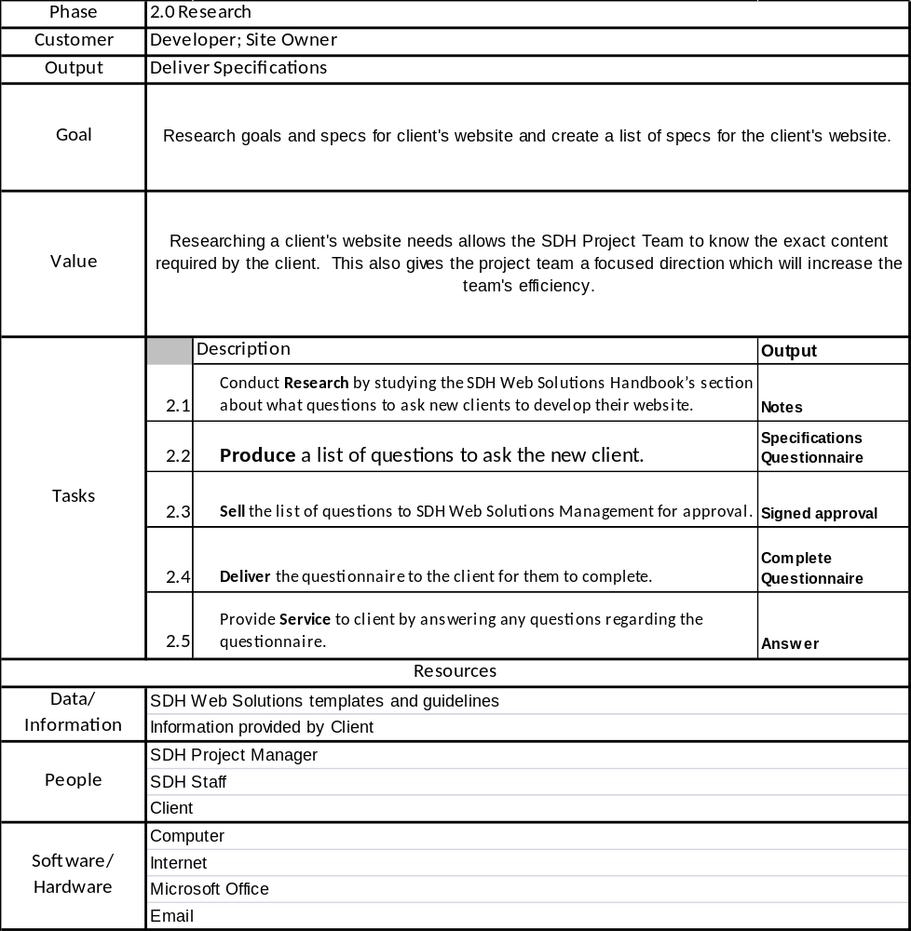
Business Analysis: Research
Table

Slide 27
Business Analysis: Research Table Narrative
Goal: Research client goals and SDH guidelines and create a list of specifications for Mr. Holm ’s website.
Product: Client Specifications.
Value: Researching Mr. Holm ’s website needs allows the SDH Project Team to know the exact content required by Mr. Holm . This also gives the project team a focused direction, increasing the team’s efficiency.
Customer: Mr. Holm and SDH Web Solutions Web Development
Work Practices
    Research: Conduct Research by studying the SDH Web Solutions Handbook’s section regarding questions to ask new clients before developing the website.
        Result: Notes.
    Produce: Produce a list of questions to ask Mr. Holm.
        Result: Client specifications questionnaire.
    Sell (Submit): Submit list of questions to SDH Web Solutions Management for approval.
        Result: Approval for questionnaire.
    Deliver: Deliver the questionnaire to Mr. Holm for him to complete.
        Result: Questionnaire completed by Mr. Holm .
    Service: Provide Service to Mr. Holm by answering any questions regarding the questionnaire.
        Result: Answers to Mr. Holm ’s questions.
Role of Data: SDH Web Solutions templates and guidelines will be provided to all employees to ensure quality of research and its results, and project management and the resulting product. Information provided by Mr. Holm will be used to ask and answer questions necessary to the Research phase.
Role of People: Martha Jean Schindler and Amanda Dobbins will conduct research. Mr. Holm will provide necessary information to SDH and answer the questionnaire.
Role of Technology: Computers, the internet, Microsoft Office, and email will be used for conducting research, producing and processing the questionnaire, and communicating among vested parties.

Slide 28
Business Analysis: Research
WCA
Data
Information provided by Mr. Holm
SDH Web Solution templates, guidelines
Data
Information provided by Mr. Holm
SDH Web Solution templates, guidelines
Participants
Martha Jean Schindler
Mr. Holm
Amanda Dobbins
Technology
Computer
Internet
Microsoft Office
Email
Work Practices
Conduct Research by studying SDH Web Solutions Handbook’s section regarding questions to ask new clients before developing the website
Produce list of questions to ask Mr. Holm
Sell (Submit) list of questions to SDH Web Solutions Management for approval
Deliver questionnaire to Mr. Holm for him or her to complete
Provide Service to Mr. Holm by answering any questions regarding the questionnaire
Goal
Research Mr. Holm goals and SDH guidelines and create a list of specifications for Mr. Holm ’s website.
Product
Mr. Holm’s Specifications
Value
Researching Mr. Holm ’s website needs allows the SDH Project Team to know the exact content required by Mr. Holm . This also gives the project team a focused direction, increasing the team’s efficiency.
Customer
Mr. Holm
SDH Web Solutions Web Development

Slide 29
Business Analysis: Research
WCA Narrative
Goal: Research client goals and SDH guidelines and create a list of specifications for Mr. Holm ’s website.
Product: Client Specifications.
Value: Researching Mr. Holm’s website needs allows the SDH Project Team to know the exact content required by Mr. Holm . This also gives the project team a focused direction, increasing the team’s efficiency.
Customer: Mr. Holm and SDH Web Solutions Web Development
Work Practices
    Research: Conduct Research by studying the SDH Web Solutions Handbook’s section regarding questions to ask new clients before developing the website.
    Produce: Produce a list of questions to ask Mr. Holm .
    Sell (Submit): Submit list of questions to SDH Web Solutions Management for approval.
    Deliver: Deliver the questionnaire to Mr. Holm for him or her to complete.
    Service: Provide Service to Mr. Holm by answering any questions regarding the questionnaire.
Role of Data: SDH Web Solutions templates and guidelines will be provided to all employees to ensure quality of research and its results, and project management and the resulting product. Information provided by Mr. Holm will be used to ask and answer questions necessary to the Research phase.
Role of People: Martha Jean Schindler and Amanda Dobbins will conduct research. Mr. Holm will provide necessary information to SDH and answer the questionnaire.
Role of Technology: Computers, the internet, Microsoft Office, and email will be used for conducting research, producing and processing the questionnaire, and communicating among vested parties.

Slide 30
Business Analysis: Research
VC
Conduct Research by studying SDH Web Solutions Handbook’s section regarding questions to ask new clients before developing the website
Value
Researching Mr. Holm’s website needs allows the SDH Project Team to know the exact content required by Mr. Holm . This also gives the project team a focused direction, increasing the team’s efficiency.
Notes
Produce list of questions to ask Mr. Holm
Client Specification Questionnaire
Sell (Submit) list of questions to SDH Web Solutions Management for approval
Approval for questionnaire
Deliver questionnaire to Mr. Holm for him or her to complete
Questionnaire completed by Mr. Holm
Product
Mr. Holm’s Specifications
Provide Service to Mr. Holm by answering any questions regarding questionnaire
Answers to client’s questions

Slide 31
Business Analysis: Research
VC Narrative
Product: Client Specifications
Value: Researching Mr. Holm’s website needs allows the SDH Project Team to know the exact content required by Mr. Holm . This also gives the project team a focused direction, increasing the team’s efficiency.
Work Practices
  Research: Conduct Research by studying SDH Web Solutions Handbook’s section regarding questions to ask new clients before developing the website
    Result: Notes
  Produce: Produce list of questions to ask Mr. Holm
    Result: Client Specification Questionnaire
  Sell (Submit): Submit list of questions to SDH Web Solutions Management for approval
    Result: Approval for questionnaire
  Deliver: Deliver questionnaire to Mr. Holm for him or her to complete
    Result: Questionnaire completed by Mr. Holm
  Service: Provide Service to Mr. Holm by answering any questions regarding questionnaire
    Result: Answers to Mr. Holm ’s questions

Slide 32
Business Analysis: Research
Work Steps
Determine Mr. Holm ’s goal for their website
  SDH offers four types of websites:
    Resume
    Relationship
    Personal Interest
    Personal Goal
Develop steps to satisfy Mr. Holm ’s goal:
  What is the best way for the website to inform about Mr. Holm ’s goal?
  What is the best way to make Mr. Holm ’s website stand out from similar sites?
  What can be done to make Mr. Holm ’s site memorable to a visitor?
List what information will be needed to complete each step
Get any information needed from Mr. Holm to satisfy steps
  Obtain at least 2 pictures (maximum 7) from Mr. Holm
  Obtain at least 1 document (maximum 2) from Mr. Holm
  Remember no website that SDH Web Solutions provides may contain audio
  Write down any information that is pertinent to paragraphs contained on website
  Obtain at least 1 (maximum 3) external hyperlink to which Mr. Holm would like his or her website to connect
  The only active web content allowed are marquees (limit 2)
  Ask if Mr. Holm wants an email link; if so obtain the email address preferred by Mr. Holm
  Have Mr. Holm choose one of SDH Web Solutions’ templates:
    All templates are a combinations of Red, Green, or Blue Backgrounds with White or Black text and a choice of Links at the top or on the left side of the web site
    See the additional page for examples of website templates
Create a list of specifications for Mr. Holm ’s website
  These specifications should include all pictures, documents, hyperlinks, and paragraphs that will be contained in the website
Have Mr. Holm sign the following:
  Client Validation and Verification Agreement
  Deadline for Submission Agreement
  Contract Detailing Goals and Specifications

Slide 33
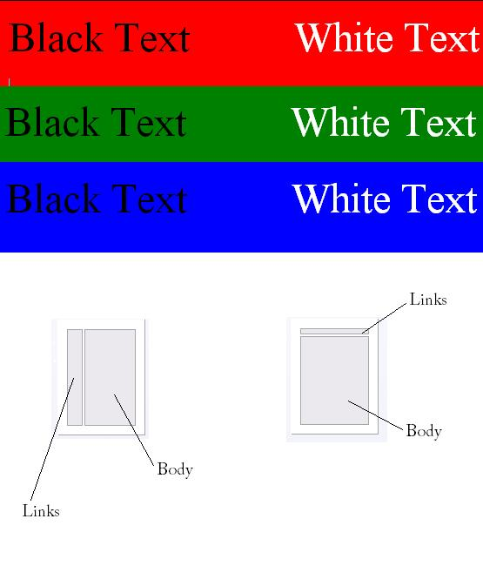
Information
Links
Links
Information
Links on Left-Side Layout
Links on Top Layout

Slide 34
SDH Web Solutions
2215 Paul W Bryant Dr
Tuscaloosa, AL 35401
(256) 683-4276
Client Validation and Verification Agreement
This is to certify that ______________, the client, agrees with the work completed through today, ____________ on his or her website. With the exception of:
Client Initials: _____ Project Manager’s Initials: _____
Unless necessary changes have been stated this document signifies the satisfactory completion of the: ___________ Phase for SDH Web Solutions.
______________________________________ ___________________
Client Date
______________________________________ ___________________
SDH Project Manager Date

Slide 35
SDH Web Solutions
2215 Paul W Bryant Dr
Tuscaloosa, AL 35401
(256) 683-4276
Deadline for Submission Agreement
This is to certify that ______________, the client, understands and accepts the fact that SDH Web Solutions will need all data to be in the website by ___________________. After said date, SDH Web Solutions is not required to any new data to the website.
______________________________________ ___________________
Client Date
______________________________________ ___________________
SDH Project Manager Date

Slide 36
SDH Web Solutions
2215 Paul W Bryant Dr
Tuscaloosa, AL 35401
(256) 683-4276
Contract Detailing Goals and Specifications
______________________________, agrees that SDH Web Solutions is developing a website to _______________________. This site will contain all specifications listed in the proceeding document. Any changes to the specifications should be listed here:
______________________________________ ___________________
Client Date
______________________________________ ___________________
SDH Project Manager Date

Slide 37
Business Analysis: Research
Completed Client Questionnaire
Pictures: bigal.jpg,
Document: jlhscholarship.pdf
Hyperlink: http://www.cba.ua.edu/mis/, http://maps.google.com/maps?q=Meridianville,+AL,+United+States+of+America&sa=X&oi=map&ct=title
Marquee: 0
Background: Red
Text: White
Layout: Links at Top
Email Address: holm001@bama.ua.edu
Information:
Index.htm paragraph:
Welcome to my website. My name is John Lee Holm and I have this website to promote my good qualities and to convince you why I am deserving of a scholarship. I am currently in my fourth year at the University of Alabama. I am a pursuing a degree in Management Information Systems. I hope that you enjoy my website.
Personal page information:
As you now know my name is John. I live in Meridianville, AL which is here: http://maps.google.com/maps?q=Meridianville,+AL,+United+States+of+America&sa=X&oi=map&ct=title.
My parents are John and Mary Holm and I am the oldest of their four children. I graduated from Grissom High School in 2004.

Slide 38
BUSINESS ANALYSIS: PRODUCE
SDH Web Solutions

Slide 39
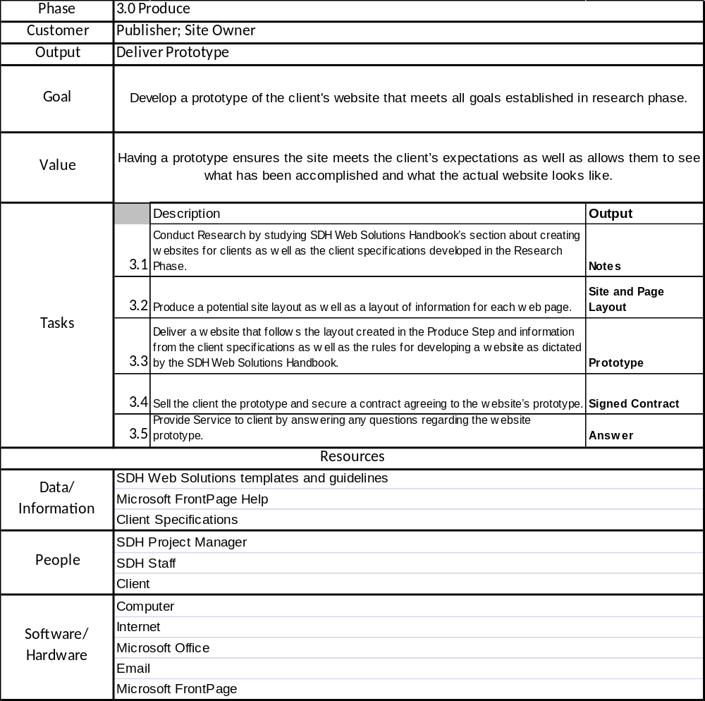
Business Analysis: Produce
Table

Slide 40
Business Analysis: Produce
Table Narrative
Goal: Develop a prototype of Mr. Holm ’s website that meets all goals established in the Research Phase.
Product: Prototype of Mr. Holm ’s Website.
Value: Developing a prototype for Mr. Holm ’s website provides a point at which the product may be reviewed by both SDH Web Solutions and Mr. Holm . This provides the opportunity to ensure that the site meets Mr. Holm ’s expectations and allows Mr. Holm to see what has been accomplished and what the actual website looks like.
Customer: Mr. Holm
Work Practices
    Research: Conduct Research by studying both the SDH Web Solutions Handbook’s regarding Mr. Holm ’s website creation and Mr. Holm’s specifications developed in the Research Phase.
        Result: Notes.
    Produce: Produce potential site layout and layout of information for each web page.
        Result: Sites and page layout.
    Deliver: Deliver website that follows layout created in Produce Step, information from Mr. Holm’s specifications, and rules for developing website as dictated by SDH Web Solutions Handbook.
        Result: Prototype website.
    Sell: Sell prototype to Mr. Holm and secure contract agreeing to website’s prototype.
        Result: Signed contract.
    Service: Provide Service to Mr. Holm by answering questions regarding website prototype.
        Result: Answers to Mr. Holm ’s questions.
Role of Data: SDH Web Solutions templates and guidelines will be provided to all employees to ensure quality of project management and the resulting product. Microsoft FrontPage Help will be used if basic problems arise during the production process. Client Specifications will be used to guide the production process appropriately.
Role of People: Martha Jean Schindler and Amanda Dobbins will oversee and conduct the website production process. Mr. Holm will approve or correct the prototype.
Role of Technology: Computers, the internet, Microsoft Office, and email will be used for production of the website and communication among vested parties. Microsoft FrontPage will be used to produce the site.

Slide 41
Business Analysis: Produce
WCA
Data
SDH Web Solutions templates and guidelines
Microsoft FrontPage Help
Client Specifications
Participants
Martha Jean Schindler
Mr. Holm
Amanda Dobbins
Technology
Computer
Internet
Microsoft Office
Email
Microsoft FrontPage
Work Practices
Conduct Research by studying SDH Web Solutions Handbook’s regarding Mr. Holm s website creation and client specifications developed in Research Phase
Produce potential site layout and layout of information for each web page
Deliver website that follows layout created in Produce Step, information from client specifications, and rules for developing website as dictated by SDH Web Solutions Handbook
Sell prototype to Mr. Holm and secure contract agreeing to website’s prototype
Provide Service to Mr. Holm by answering questions regarding website prototype
Goal
Develop a prototype of Mr. Holm ’s website that meets all goals established in the Research Phase.
Product
Prototype of Mr. Holm ’s Website
Value
Developing a prototype for Mr. Holm ’s website provides a point at which the product may be reviewed by both SDH Web Solutions and Mr. Holm . This provides the opportunity to ensure that the site meets Mr. Holm ’s expectations and allows Mr. Holm to see what has been accomplished and what the actual website looks like.
Customer
Mr. Holm
SDH Web Solutions Publishing Team

Slide 42
Business Analysis: Produce
WCA Narrative
Goal: Develop a prototype of Mr. Holm ’s website that meets all goals established in the Research Phase.
Product: Prototype of Mr. Holm ’s Website.
Value: Developing a prototype for Mr. Holm ’s website provides a point at which the product may be reviewed by both SDH Web Solutions and Mr. Holm . This provides the opportunity to ensure that the site meets Mr. Holm ’s expectations and allows Mr. Holm to see what has been accomplished and what the actual website looks like.
Customer: Mr. Holm
Work Practices
    Research: Conduct Research by studying both the SDH Web Solutions Handbook’s regarding Mr. Holm ’s website creation and Mr. Holm specifications developed in the Research Phase
    Produce: Produce potential site layout and layout of information for each web page
    Deliver: Deliver website that follows layout created in Produce Step, information from client specifications, and rules for developing website as dictated by SDH Web Solutions Handbook
    Sell: Sell prototype to Mr. Holm and secure contract agreeing to website’s prototype
    Service: Provide Service to Mr. Holm by answering questions regarding website prototype
Role of Data: SDH Web Solutions templates and guidelines will be provided to all employees to ensure quality of project management and the resulting product. Microsoft FrontPage Help will be used if basic problems arise during the production process. Client Specifications will be used to guide the production process appropriately.
Role of People: Martha Jean Schindler and Amanda Dobbins will oversee and conduct the website production process. Mr. Holm will approve or correct the prototype.
Role of Technology: Computers, the internet, Microsoft Office, and email will be used for production of the website and communication among vested parties. Microsoft FrontPage will be used to produce the site.

Slide 43
Business Analysis: Produce
VC
Conduct Research by studying SDH Web Solutions Handbook’s section regarding client website creation and client specifications developed in Research Phase
Value
Developing a prototype for Mr. Holm ’s website provides a point at which the product may be reviewed by both SDH Web Solutions and Mr. Holm . This provides the opportunity to ensure that the site meets Mr. Holm ’s expectations and allows Mr. Holm to see what has been accomplished and what the actual website looks like.
Notes
Produce potential site layout and layout of information for each web page
Site and Page Layout
Deliver website that follows layout created in Produce Step, information from client specifications, and rules for developing website as dictated by SDH Web Solutions Handbook
Prototype website
Sell prototype to Mr. Holm and secure contract agreeing to website’s prototype
Signed Contract
Product
Prototype for Mr. Holm ’s Website
Provide Service to Mr. Holm by answering questions regarding website prototype
Answers to Mr. Holm ’s questions

Slide 44
Business Analysis: Produce
VC Narrative
Product: Prototype for Mr. Holm ’s Website
Value: Developing a prototype for Mr. Holm ’s website provides a point at which the product may be reviewed by both SDH Web Solutions and Mr. Holm . This provides the opportunity to ensure that the site meets Mr. Holm ’s expectations and allows Mr. Holm to see what has been accomplished and what the actual website looks like.
Work Practices
    Research: Conduct Research by studying SDH Web Solutions Handbook’s section regarding client website creation and client specifications developed in Research Phase.
        Result: Notes.
    Produce: Produce potential site layout and layout of information for each web page.
        Result: Site and Page Layout.
    Deliver: Deliver website that follows layout created in Produce Step, information from client specifications, and rules for developing website as dictated by SDH Web Solutions Handbook.
        Result: Prototype website.
    Sell: Sell prototype to Mr. Holm and secure contract agreeing to website’s prototype.
        Result: Signed Contract.
    Service: Provide Service to Mr. Holm by answering questions regarding website prototype.
        Result: Answers to Mr. Holm ’s questions.

Slide 45
Business Analysis: Produce
Work Steps
Sketch the site layout
  This is a diagram how each page in the website relates to each other
  See Example A on the following page for additional information
Sketch the page layout of each page in the website.
  This is a diagram of how each page in the website is setup
  See Example B on the following page for additional information
Using all information create the different web pages.
  Should use Client Specifications, SDH Web Solutions Handbook, and Site and Page Layout documents
Verify that the pages function as stated by the site layout and look like the page layout
Submit the prototype for client review and approval
  Be sure to acquire a signed Client Validation and Verification Agreement

Slide 46
Example A
Home
Second Page
File
External Link
Third Page
Example B
Link to second.htm
Link to file.pdf
Link to third.htm
Marquee
Picture
Paragraph with link external link

Slide 47
SDH Web Solutions
2215 Paul W Bryant Dr
Tuscaloosa, AL 35401
(256) 683-4276
Client Validation and Verification Agreement
This is to certify that ______________, the client, agrees with the work completed through today, ____________ on his or her website. With the exception of:
Client Initials: _____ Project Manager’s Initials: _____
Unless necessary changes have been stated this document signifies the satisfactory completion of the: ___________ Phase for SDH Web Solutions.
______________________________________ ___________________
Client Date
______________________________________ ___________________
SDH Project Manager Date

Slide 48
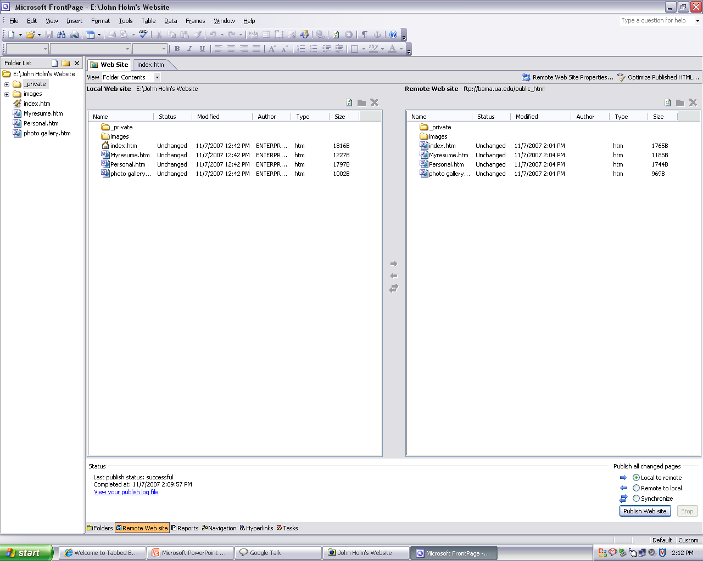
Produce
Publishing the Website

Slide 49
BUSINESS ANALYSIS: DELIVER
SDH Web Solutions

Slide 50
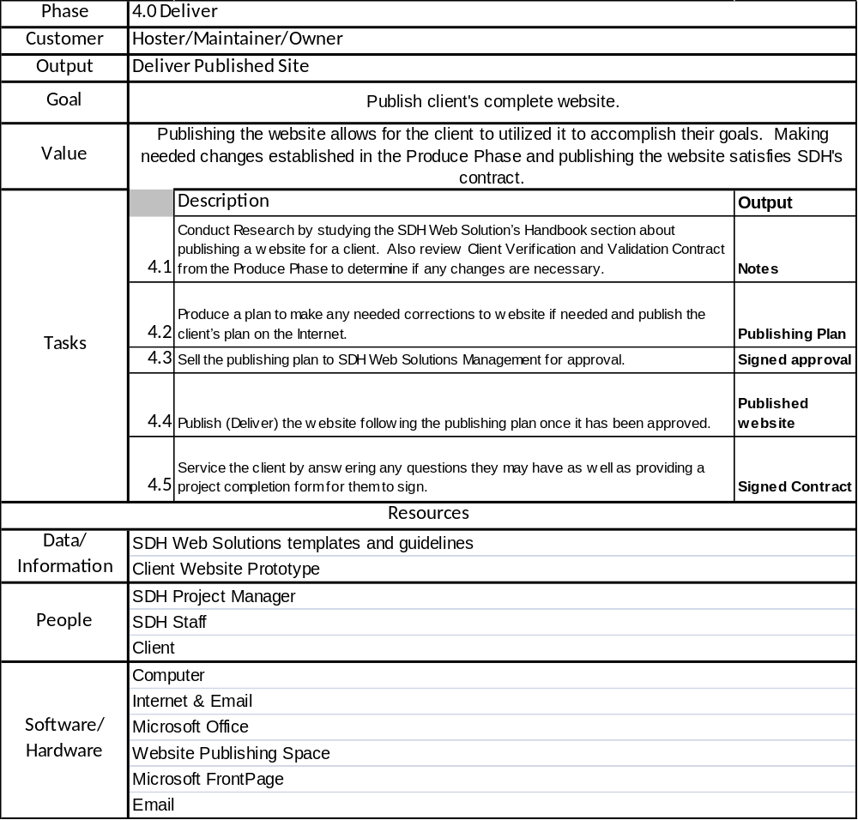
Business Analysis: Deliver
Table

Slide 51
Business Analysis: Deliver
Table Narrative
Product: Published Client Website
Value: Publishing the website allows Mr. Holm to use the website to accomplish his or her goals. Making needed changes established in the Produce Phase and publishing Mr. Holm 's website satisfies our contract with Mr. Holm , unless a service contract is signed.
Work Practices
    Research: Conduct Research by studying SDH Web Solution’s Handbook section regarding client website publication; review Client Verification and Validation Contract from Produce Phase to determine if any changes are necessary.
        Result: Notes.
    Produce: Produce plan to make corrections to website if needed and publish Mr. Holm ’s plan on Internet.
        Result: Publishing Plan.
    Sell: Sell (Submit) publishing plan to SDH Web Solutions Management for approval.
        Result: Approval of publishing plan
    Deliver: Deliver (Publish) website following approval of publishing plan
        Result: Published client website
    Service: Provide Service to Mr. Holm by answering any questions he or she has and offering a project completion form for him or her to sign
        Result: Signed Completion of Project Agreement
Role of Data: SDH Web Solutions templates and guidelines will be provided to all employees to ensure quality of project management and the resulting product. Mr. Holm website prototype will be published,
Role of People: Martha Jean Schindler and SDH staff will oversee and conduct the delivery (publication) process. Mr. Holm will receive his or her completed website, ready for use.
Role of Technology: Computers, the internet, Microsoft Office, and email will be used for production of the website and communication among vested parties. Microsoft FrontPage and the web space will be used to produce and publish the site.

Slide 52
Business Analysis: Deliver
WCA
Data
SDH Web Solutions templates, guidelines
Client Website Prototype
Participants
Martha Jean Schindler
Amanda Dobbins
Mr. Holm
Technology
Computers
Internet & email
Microsoft FrontPage
Microsoft Office
Web space to Publish
Work Practices
Conduct Research by studying SDH Web Solution’s Handbook section regarding client website publication; also review Client Verification and Validation Contract from Produce Phase to determine if any changes are necessary
Produce plan to make corrections to website if needed and publish Mr. Holm ’s plan on Internet
Sell (Submit) publishing plan to SDH Web Solutions Management for approval
Deliver (Publish) website following approval of publishing plan
Provide Service to Mr. Holm by answering any questions he or she may have and offering project completion form for him or her to sign
Goal
Publish Mr. Holm 's complete website.
Product
Published and Operable Website
Value
Publishing the website allows Mr. Holm to use the website to accomplish his or her goals. Making needed changes established in the Produce Phase and publishing Mr. Holm 's website satisfies our contract with Mr. Holm , unless a service contract is signed.
Customer
Mr. Holm

Slide 53
Business Analysis: Deliver
WCA Narrative
Goal: Publish Mr. Holm 's complete website.
Product: Published and operable website.
Value: Publishing the website allows Mr. Holm to use the website to accomplish his or her goals. Making needed changes established in the Produce Phase and publishing Mr. Holm 's website satisfies our contract with Mr. Holm , unless a service contract is signed.
Customer: Mr. Holm .
Work Practices
    Research: Conduct Research by studying the SDH Web Solution’s Handbook section regarding client website publication; also review Client Verification and Validation Contract from the Produce Phase to determine if any changes are necessary.
    Produce: Produce a plan to make corrections to the website if needed and publish Mr. Holm ’s plan on the Internet.
    Sell (Submit): Sell (Submit) publishing plan to SDH Web Solutions Management for approval.
    Deliver (Publish): Deliver (Publish) the website following approval of the publishing plan.
    Service: Provide Service to Mr. Holm by answering any questions he or she may have and offering project completion form for him or her to sign.
Role of Data: SDH Web Solutions templates and guidelines will be provided to all employees to ensure quality of project management and the resulting product. Mr. Holm website prototype will be published,
Role of People: Martha Jean Schindler and SDH staff will oversee and conduct the delivery (publication) process. Mr. Holm will receive his or her completed website, ready for use.
Role of Technology: Computers, the internet, Microsoft Office, and email will be used for production of the website and communication among vested parties. Microsoft FrontPage and the web space will be used to produce and publish the site.

Slide 54
Business Analysis: Deliver
VC
Conduct Research by studying SDH Web Solution’s Handbook section regarding client website publication; review Client Verification and Validation Contract from Produce Phase to determine if any changes are necessary
Value
Publishing the website allows Mr. Holm to use the website to accomplish his or her goals. Making needed changes established in the Produce Phase and publishing Mr. Holm 's website satisfies our contract with Mr. Holm , unless a service contract is signed.
Notes
Produce plan to make corrections to website if needed and publish Mr. Holm ’s plan on Internet
Publishing Plan
Sell (Submit) publishing plan to SDH Web Solutions Management for approval
Approval for publishing plan
Publish (Deliver) website following approval of publishing plan
Published client website
Product
Published Mr. Holm Website
Provide Service to Mr. Holm by answering any questions he or she has and offering a project completion form for him or her to sign
Signed Completion of Project Agreement

Slide 55
Business Analysis: Deliver
VC Narrative
Product: Published Client Website
Value: Publishing the website allows Mr. Holm to use the website to accomplish his or her goals. Making needed changes established in the Produce Phase and publishing Mr. Holm 's website satisfies our contract with Mr. Holm , unless a service contract is signed.
Work Practices
    Research: Conduct Research by studying SDH Web Solution’s Handbook section regarding client website publication; review Client Verification and Validation Contract from Produce Phase to determine if any changes are necessary.
        Result: Notes.
    Produce: Produce plan to make corrections to website if needed and publish Mr. Holm ’s plan on Internet.
        Result: Publishing Plan.
    Sell: Sell (Submit) publishing plan to SDH Web Solutions Management for approval.
        Result: Approval of publishing plan
    Deliver: Deliver (Publish) website following approval of publishing plan
        Result: Published client website
    Service: Provide Service to Mr. Holm by answering any questions he or she has and offering a project completion form for him or her to sign
        Result: Signed Completion of Project Agreement

Slide 56
Business Analysis: Deliver
Work Steps
Make any changes that Mr. Holm requested in the Produce Phase
Publish Mr. Holm ’s website
  For reference about publishing a website refer to the guide on the next page
Show published website to Mr. Holm and get their final approval
  Be sure to have them sign the Completion of Project Agreement

Slide 57
SDH Web Solutions
2215 Paul W Bryant Dr
Tuscaloosa, AL 35401
(256) 683-4276
Completion of Project Agreement
This is to certify that ______________, the client, agrees with the work completed for his or her website. This document signifies the SDH Web Solutions has satisfied its Contract for Services with _____________.
______________________________________ ___________________
Client Date
______________________________________ ___________________
SDH Project Manager Date

Slide 58
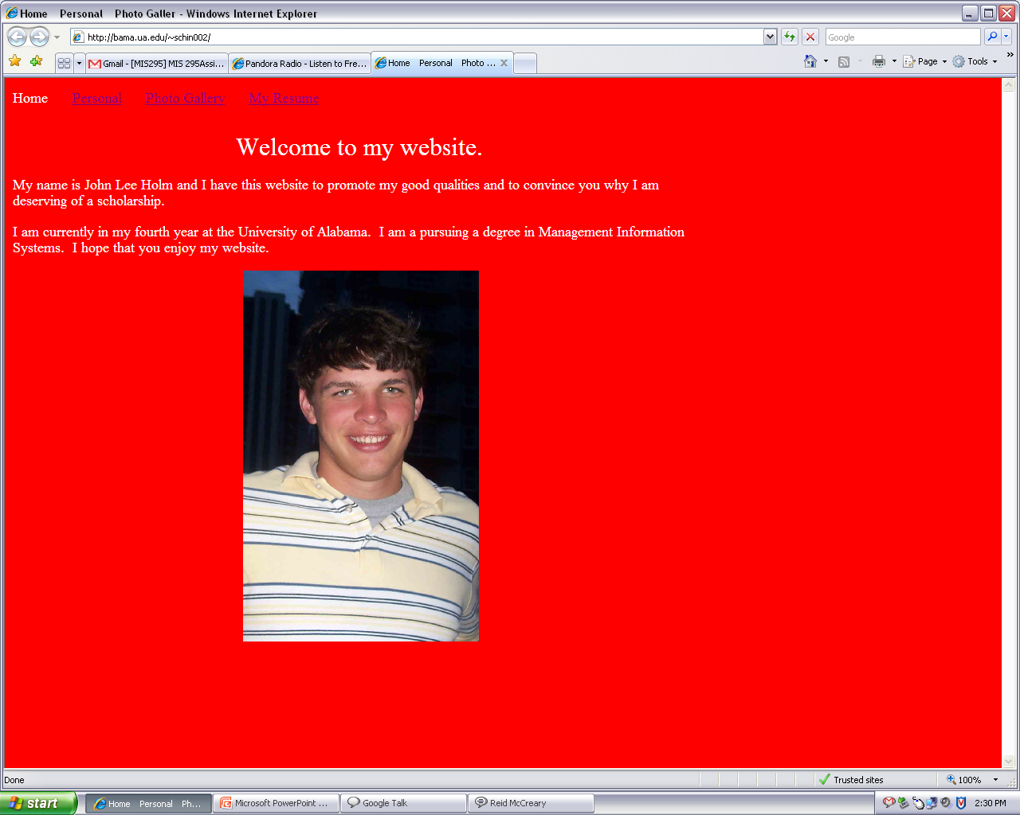
Deliver
Final Website Home Page

Slide 59
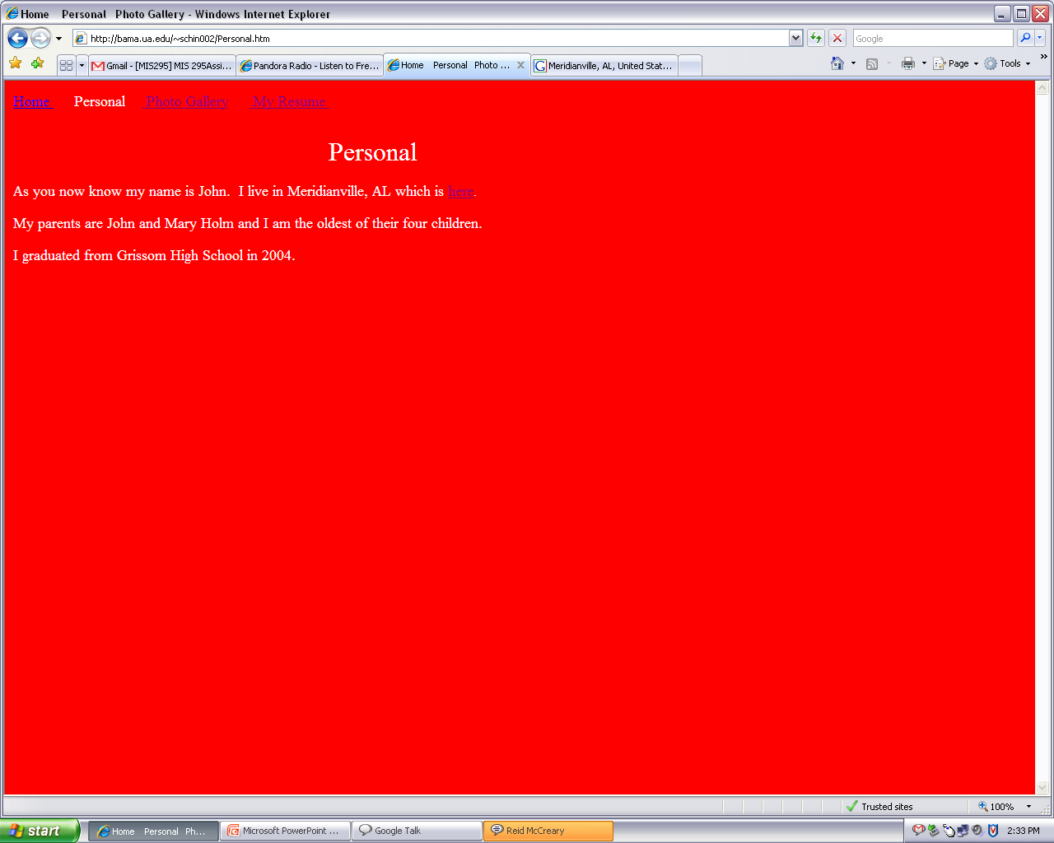
Deliver
Final Website Personal Page

Slide 60
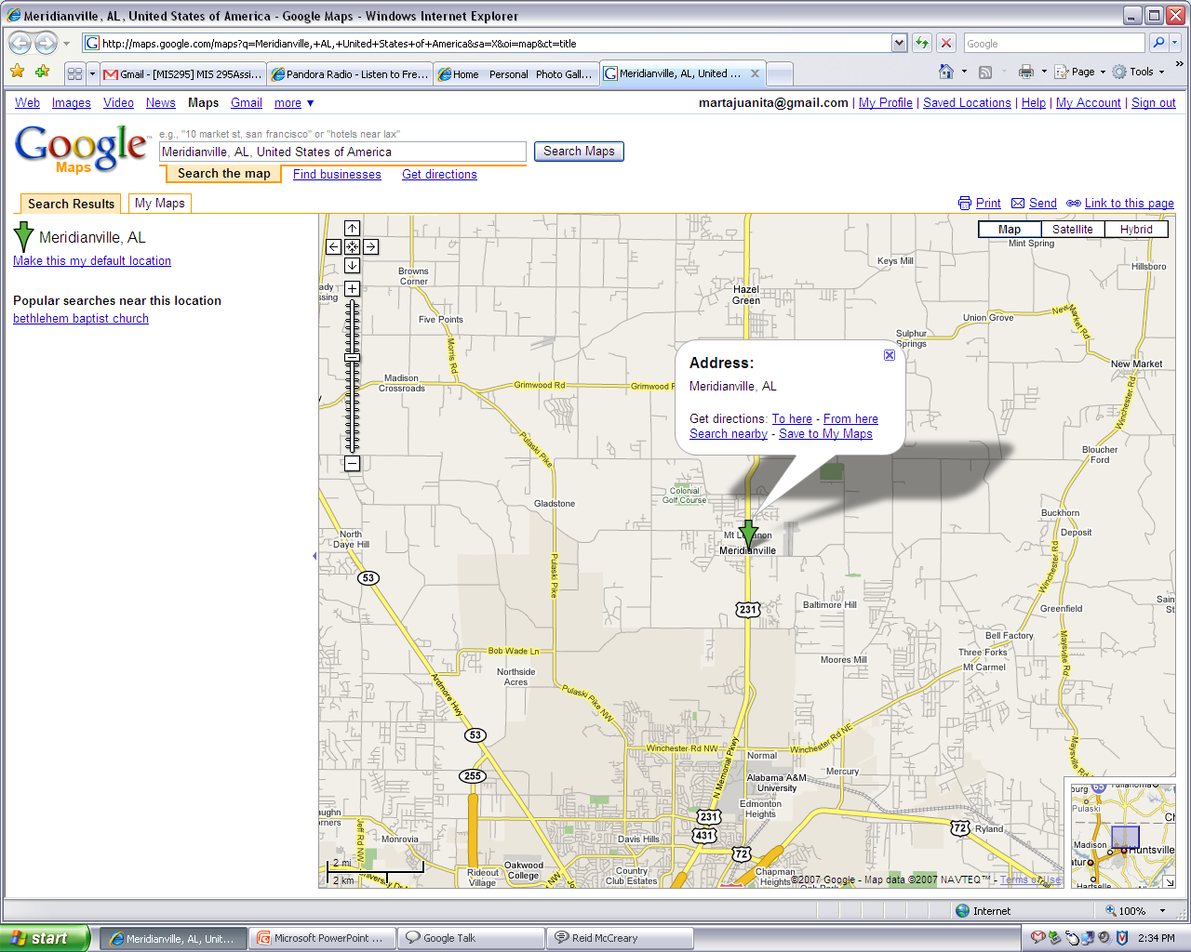
Deliver
Final Website Personal Page Link

Slide 61
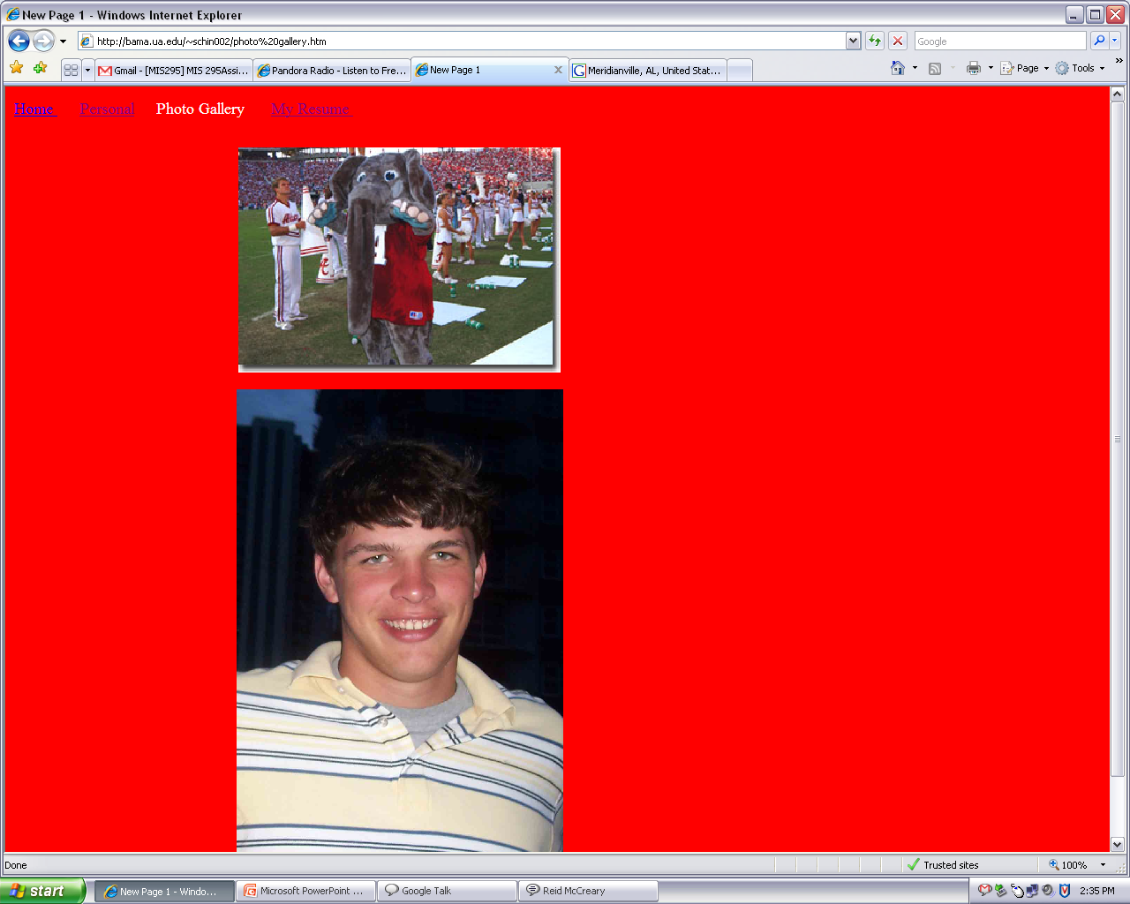
Deliver
Final Website Photo Gallery Page

Slide 62
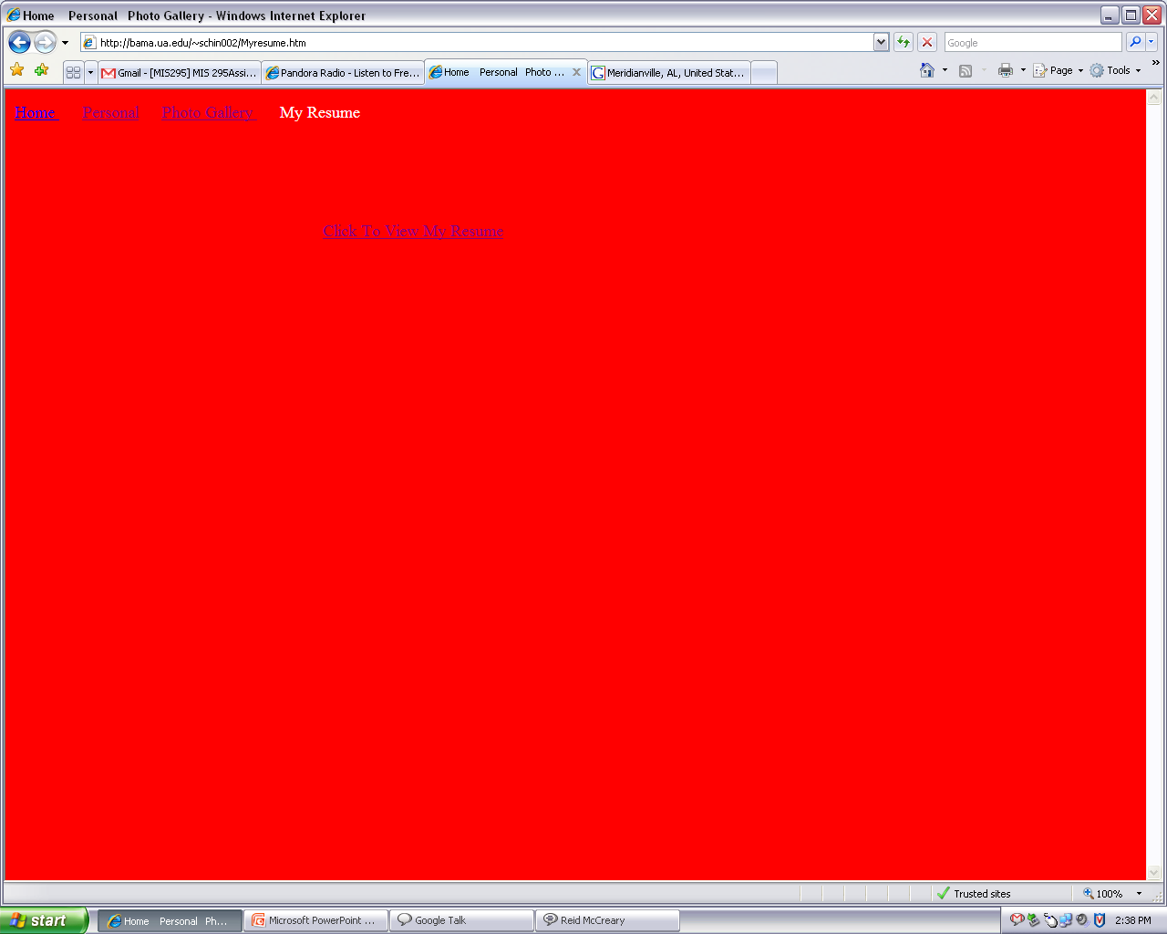
Deliver
Final Website My Resume Page

Slide 63
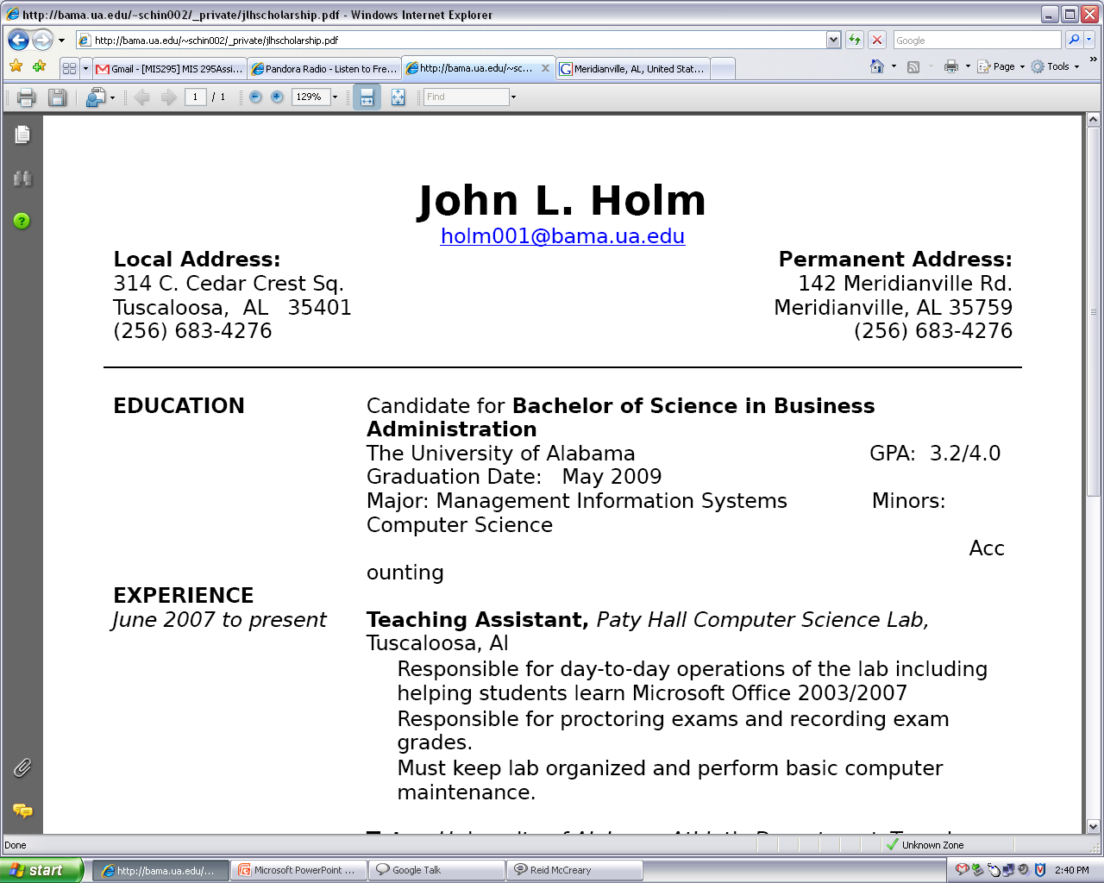
Deliver
Final Website Resume Link

Slide 64
BUSINESS ANALYSIS: SERVICE
SDH Web Solutions

Slide 65
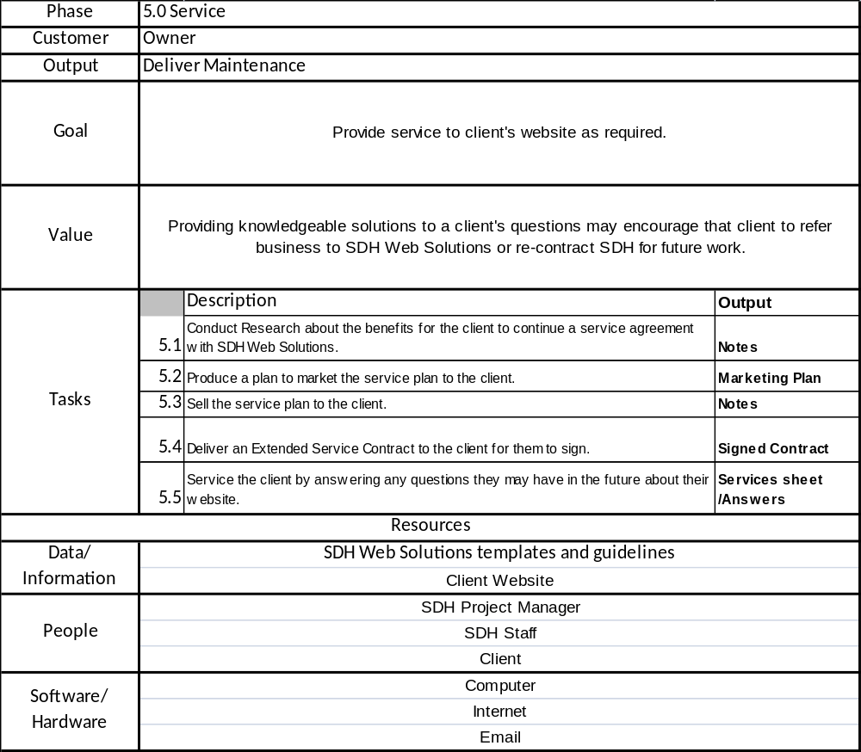
Business Analysis: Service
Table

Slide 66
Business Analysis: Service
Table Narrative
Goal: To provide service to Mr. Holm ’s website as required.
Value: Providing knowledgeable solutions to a Mr. Holm 's questions encourages Mr. Holm to refer business to SDH Web Solutions or re-contract SDH for future work.
Product: Maintenance of website
Customer: Mr. Holm
Work Practices:
    Research: Conduct research about the benefits of a service agreement with SDH Web Solutions for Mr. Holm .
        Results: Notes
    Produce: Produce a plan to market the service plan to Mr. Holm .
        Results: Marketing Plan
    Sell: Sell the service plan to Mr. Holm .
        Results: Notes
    Deliver: Deliver an Extended Service Contract to Mr. Holm for Mr. Holm to sign.
        Results: Signed Extended Service Contract
    Service: Provide service to Mr. Holm by answering any questions he or she may have in the future about the website.
        Results: Client’s Service Information and fully complete answers to Mr. Holm ’s questions
Role of Data: SDH Web Solutions templates are used as guidelines for the project management and
production of the product. The information from Mr. Holm about his or her website is maintained.
Role of People: The Project Manager of SDH oversees decisions made regarding Mr. Holm and the
client’s site. Members of the SDH staff do administrative work. Mr. Holm will be provided the service.
Role of Technology: Computers are used to maintain Mr. Holm ’s website and serve as a means of
communication between Mr. Holm and SDH Web Solutions.

Slide 67
Business Analysis: Service
WCA
Data
SDH Web Solutions templates, guidelines
Client Website
Participants
Martha Jean Schindler
Amanda Dobbins
Mr. Holm
Technology
Computers
Internet & email
Work Practices
Conduct Research about benefits for Mr. Holm to continue service agreement with SDH Web Solutions
Produce plan to market service plan to Mr. Holm
Sell service plan to Mr. Holm
Deliver Extended Service Contract to Mr. Holm for him to sign
Provide Service to Mr. Holm by answering any future questions he may have about website
Goal
Provide service to Mr. Holm 's website as required.
Product
Maintenance
Value
Providing knowledgeable solutions to Mr. Holm's questions encourages Mr. Holm to refer business to SDH Web Solutions or re-contract SDH for future work.
Customer
Mr. Holm

Slide 68
Business Analysis: Service WCA Narrative
Goal: To provide service to Mr. Holm ’s website as required.
Value: Providing knowledgeable solutions to his questions encourages Mr. Holm to refer business to SDH Web Solutions or re-contract SDH for future work.
Product: Maintenance of website
Customer: Mr. Holm
Work Practices:
    Research: Conduct research about the benefits of a service agreement with SDH Web Solutions for Mr. Holm .
    Produce: Produce a plan to market the service plan to Mr. Holm .
    Sell: Sell the service plan to Mr. Holm .
    Deliver: Deliver an Extended Service Contract to Mr. Holm for Mr. Holm to sign.
    Service: Provide service to Mr. Holm by answering any questions he or she may have in the future about the website.
Role of Data: SDH Web Solutions templates are used as guidelines for the project management and
production of the product. The information from Mr. Holm about his or her website is maintained.
Role of People: The Project Manager of SDH oversees decisions made regarding Mr. Holm and the
site. Members of the SDH staff do administrative work. Mr. Holm will be provided the service.
Role of Technology: Computers are used to maintain Mr. Holm ’s website and serve as a means of
communication between Mr. Holm and SDH Web Solutions.

Slide 69
Business Analysis: Service
VC
Conduct Research about benefits for Mr. Holm to continue service agreement with SDH Web Solutions
Value
Providing knowledgeable solutions to his questions may encourage Mr. Holm to refer business to SDH Web Solutions or re-contract SDH for future work.
Notes
Produce plan to market service plan to Mr. Holm
Marketing Plan
Sell service plan to Mr. Holm
Notes
Deliver Extended Service Plan Contract to Mr. Holm for him to sign
Signed Extended Service Contract
Product
Maintenance
Provide Service to Mr. Holm by answering any future questions he or she may have about website
Client’s Service Information and fully complete answers to Mr. Holm ’s questions

Slide 70
Business Analysis: Service
VC Narrative
Product: Maintenance
Value: Providing knowledgeable solutions to his questions may encourage Mr. Holm to refer
business to SDH Web Solution or re-contract SDH for future work.
Work Practices
    Research: Conduct Research about the benefits for Mr. Holm to continue a service agreement with SDH Web Solutions.
        Result: Notes.
    Produce: Produce a plan to market the service plan to Mr. Holm .
        Result: Marketing plan.
    Sell: Sell the service plan to Mr. Holm .
        Result: Notes.
    Deliver: Deliver an Extended Service Plan Contract to for Mr. Holm to sign.
        Result: Signed Extended Service Contract.
    Service: Service Mr. Holm by answering any questions they may have in the future about their website.
        Result: Client’s service information. Complete and full answers to client’s questions.

Slide 71
Business Analysis: Service
Work Steps
Inform Mr. Holm of benefits of using an Extended Service Plan provide by SDH Web Solutions.
Have Mr. Holm sign Extended Service Contract.
Be able to provide solutions to Mr. Holm as required.
  Refer to the SDH Web Solutions Handbook, Client Specifications, and Site and Page Layout Documents.

Slide 72
SDH Web Solutions
2215 Paul W Bryant Dr
Tuscaloosa, AL 35401
(256) 683-4276
Extended Service Contract
This contract states which if any service plan the client opts to use with the completion their website:

 1 Year Service Package at $225.00
 2 Year Service Package at $350.00
 Lifetime Service Package at $500.00
 I will not buying a Service Package. I agree to be responsible for any fees the website may incur.
All service packages include all costs associated with hosting the site web, 24 hour email and phone support, and Minor updates to customer’s site.
Additionally, purchasing a 2 Year Service Package or Lifetime Service Package will give customers a $75.00 rebate on their next site with SDH Web Solutions.
Minor updates include changes to text on site as well as links and graphics. Minor updates do not include changes to site structure or major redesign of site.
SDH Web Solutions reserves the right to make the final decision on what constitutes a major and minor update.
______________________________________ ___________________
Client Date
______________________________________ ___________________
SDH Project Manager Date

Slide 73
REPOSITORY
SDH Web Solutions

